Slide 1

SERBA2C INDIA PVT LTD
Serba2c India Private Limited
Corporate Office: Rattha Technology park , No. 51,3rd floor ,Tower B,
Tek meadows,OMR,
Sholinganallur,Chennai,Tamil Nadu 600119. India.
Website: www.serba2c.com

Slide 2








About Us
About Us
Product
Company
Digital
Transformation
Low Code
Platform
+
BPM Platform
For Complex, Process Centric Enterprise Apps built By IT Users
XR Framework
Solutions and Services around the platform
We are a passionate team of technology mavericks and we love what we do – be it powering your business with cutting edge technology or help you transform your business with Automation solutions.

Slide 3





Our Culture
At AND, We see the future. We see the potential for business leaders to guide this evolution by changing their organizations, industries, and
society at large. Our company Values and our Code of Conduct are the basis for how we do business.
CUSTOMER DELIGHT
INTEGRITY
LEADERSHIP
EXCELLENCE
CREATIVITY
To anticipate the customers requirements and provide services, surpassing their expectations.
To be ethical, act to establish the foremost standards of honesty and fairness in all our actions.
Strong leadership focus with the intent, efforts to lead by example and set standards in each segment we operate in.
Work together to improve to become the best, to maintain and expand our tradition of “Excellence
through Quality”.
Work for breakthrough Innovations and explore the possibilities of the future.

Slide 4
Our Expertise
Solutions
Enterprise Solutions
Provide the best solution to integrate real-time, enterprise, and communication services for businesses which are used for efficient production operations.
Data Center & Disaster Recovery Solutions
Every new data center deployment is unique and we take a collaborative approach to the design process. With our certified design experts, knowledge of industry best practices whether greenfield build or colocation we will work together with all stakeholders in order to unleash the full potential of your new space. Ensure that your organization can still accomplish its mission and would not lose the capability to process, retrieve and protect information maintained in the event of an interruption or disaster leading to temporary or permanent loss of computer facilities.
Unified Solutions
Provide the combination of secured communications and collaboration tools into a simple interface for improved customer satisfaction and user experience
Smartcity IOT- Solutions
IoT-as-a-service enabling organizations to transform business needs into competitive differentiators by delivering innovative IoT solutions for Smart Cities
Virtualization & Application Delivery
Extensive expertise in storing applications on a hosting service or in a data center and then distribute them to a user’s desktop

Slide 5





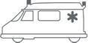






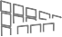








Smartcity – IOT Solutions
A Combination of many Vertical Solutions on a Common Infrastructure
Medical & Healthcare
Logistics & Networking
Security & Surveillance
Transportation & Mobility
SMART CITY - IOT
Utilities & Constructions

Slide 6





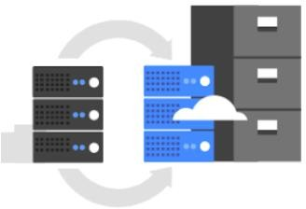




Smartcity – IOT Solutions
Command and Control Center (CCC)
Smart Governance Portal.
Integration of Existing Systems & Utility Systems.
Smart Data Center Solution
Hosted on Cloud.
Hybrid
Network Connectivity
Laying & Commissioning of Fiber Network for Internet cable Bandwidth.
Variable Messaging Board
City Surveillance System & Disaster Management System
Integration of Smart Parking system
Mobile Command & Control Center
Smart Sensors
Smart Poles
Smart Street Light Management
Public Address System
Emergency Call Box
Telecom BTS
ICT based Smart Solid waste/bin
Management system

Slide 7



Introduction to I PROOF Platform
What we Do – Platform based development
Change the way IT System are Built and managed Using
iPROOF Low Code Platform & Digital Process Framework
Low Code Platform
Digital Process Framework
Rapid Development of Complex, Business Centric Enterprise Apps

Slide 8
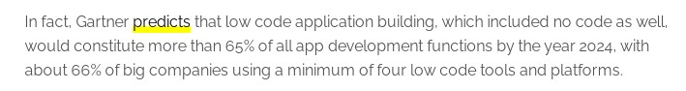
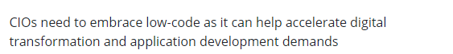
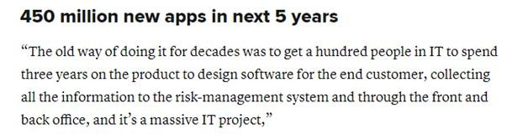
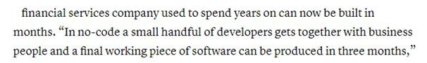
Low Code Platform – the future of All Development
Industry experts predict 65% of all development would be through low code platforms
Low code platform with BPM shall drive Digital Transformation

Slide 9








Sample set of Apps built using the platform
 |  | Ministry of Education Zambia Digital Transformation Initiative of Ministry of General Education (Project Planning, Management & Monitoring system)
Ford Motors Robotics Process Automation – OCR, Rule based automation | Zamtel iPROOF as a Digital Channel and Transformation Platform(Through Zcom systems – our local partner)
IIT Madras End to End Institute Management system – 300 + Process Apps | Serba Dinamik Digital Turnaround and Maintenance - for Oil and Gas with ML, IoT Virtual Reality/Augmented Reality | Banc ABC Layer Around Flexcube - Lending, Collection System etc
VICE CORE Integrated Process Driven ERP (With Integrated POS System) | MFZ End to end Loan Management System | Ad-hoc or Dynamic Apps – R&D and New Product Development

Slide 10



Smartcity – Videowall Solutions
Traffic
Process
Our Video wall solution delivers a reliable, flexible and revolutionary solution that caters to traffic management needs. Our 24x7 display solutions enable crucial control rooms to analyze the situation in real
time ensuring safety to the commuters.
Ideal for 24x7 operations, Our Video walls enable information sharing and analyzing mission-critical data in real time. The cubes used in all Our rear projection video walls are powered by DLP technology, generating extraordinary image quality with incredible color depth and contrast.
Surveillance
Command & Control
Our Video wall solutions powered by DLP® technology help operators to monitor, analyze and act on any suspicious activity. With the help of Our display walls, security officers can keep a round-the- clock vigil on all the movements on sensitive areas
and activities.
Our DLP® video walls for Command & Control enable the control rooms to analyze the situation in the right frame and respond accordingly.
Broadcast
Corporate
Our video wall solutions are designed for real and expanding requirements for large scale visualization systems that are ideally suited for over the shoulder display, broadcast monitoring rooms, screening or post-
production environments
With various connectivity ports Our Next-Gen Video walls help display numerous amounts of data to analyze information effectively
Telecom
Utilities
Our display solutions are playing a vital role in setting up utility control rooms that enable the teams working in these fields, to work efficiently with prompt and rationale response. Our reliable and highly flexible Video wall solutions
Our rich experience in developing key telecom and power products helps it to understand the dynamics and sustainable needs of this application. Our Video walls' robust design with the latest in technology ensures redundancy in 24/7 monitoring applications.

Slide 11












Solution Portfolio
Telecom
Endless possibilities
Only limited by our imagination
Manufacturing
Rapidly develop any type of application – Cross platform
(Web, Mobile, Tablet, Microsoft Hololens, Mobile AR devices)
Healthcare
Education
eGovernance
Generic ERP Modules
Oil and Gas
Financial Services
iPROOF Digital Transformation Platform with Industry 4.0 Capabilities
Low Code and BPM Platform
IOT Framework
Mixed Reality/Augmented Reality/ Virtual Reality Framework
Machine Learning/ Analytics

Slide 12
Our Open Data and Analytics Capabilities
Open Data
Data Governance
Data Quality
Data Management
Data Profiling
Data Enrichment
Data Integration
Data Mapping
Data Transformations
HADOOP Distribution
Oracle 12C
SAP HANA
SAP Business Planning and Consolidations
(BPC)
SAP
Master Data Management (MDM)
SAP
Business Objects(BO) Tools
Data & Analytics
Analytics
Planning and Forecasting
Predictive Analytics
Advanced Analytics
Data Discovery
Interactive Analytics
Self Servicing and Ad-Hoc Query
Dashboards and Data Visualization
Scenario Analysis
Business Insights
Enterprise Reporting
Management Reporting
Operational Insights
SAP
Business Warehouse (BW)
Open Source
SPAGOBI
Pentaho
JasperReport
Open Source Technologies
“R”
Python

Slide 13
Project Monitoring Solutions
Project works are awarded to Vendors, Engineering / Supervisory staff, Budgets & Time lines allocated.
Project are created and monitored, Mobiles are used to capture the Last mile data and work progress on a regular basis with multi-media data evidencing
Dashboards provide all kinds of reporting and charting for quick glance information.
Citizens get first hand information of all the projects through project websites leading to better Transparency
Complaints can be logged and tracked to a logical closure.
Projects undertaken show up in Geographical Map
PMS - CMS
SEMS
Mother Child Tracking
PRS
People Representative Solution
MCTS
Smart Election Monitoring
Project Monitoring System
Construction Monitoring System
Swachh Bharat
Sanitation Survey

Slide 14
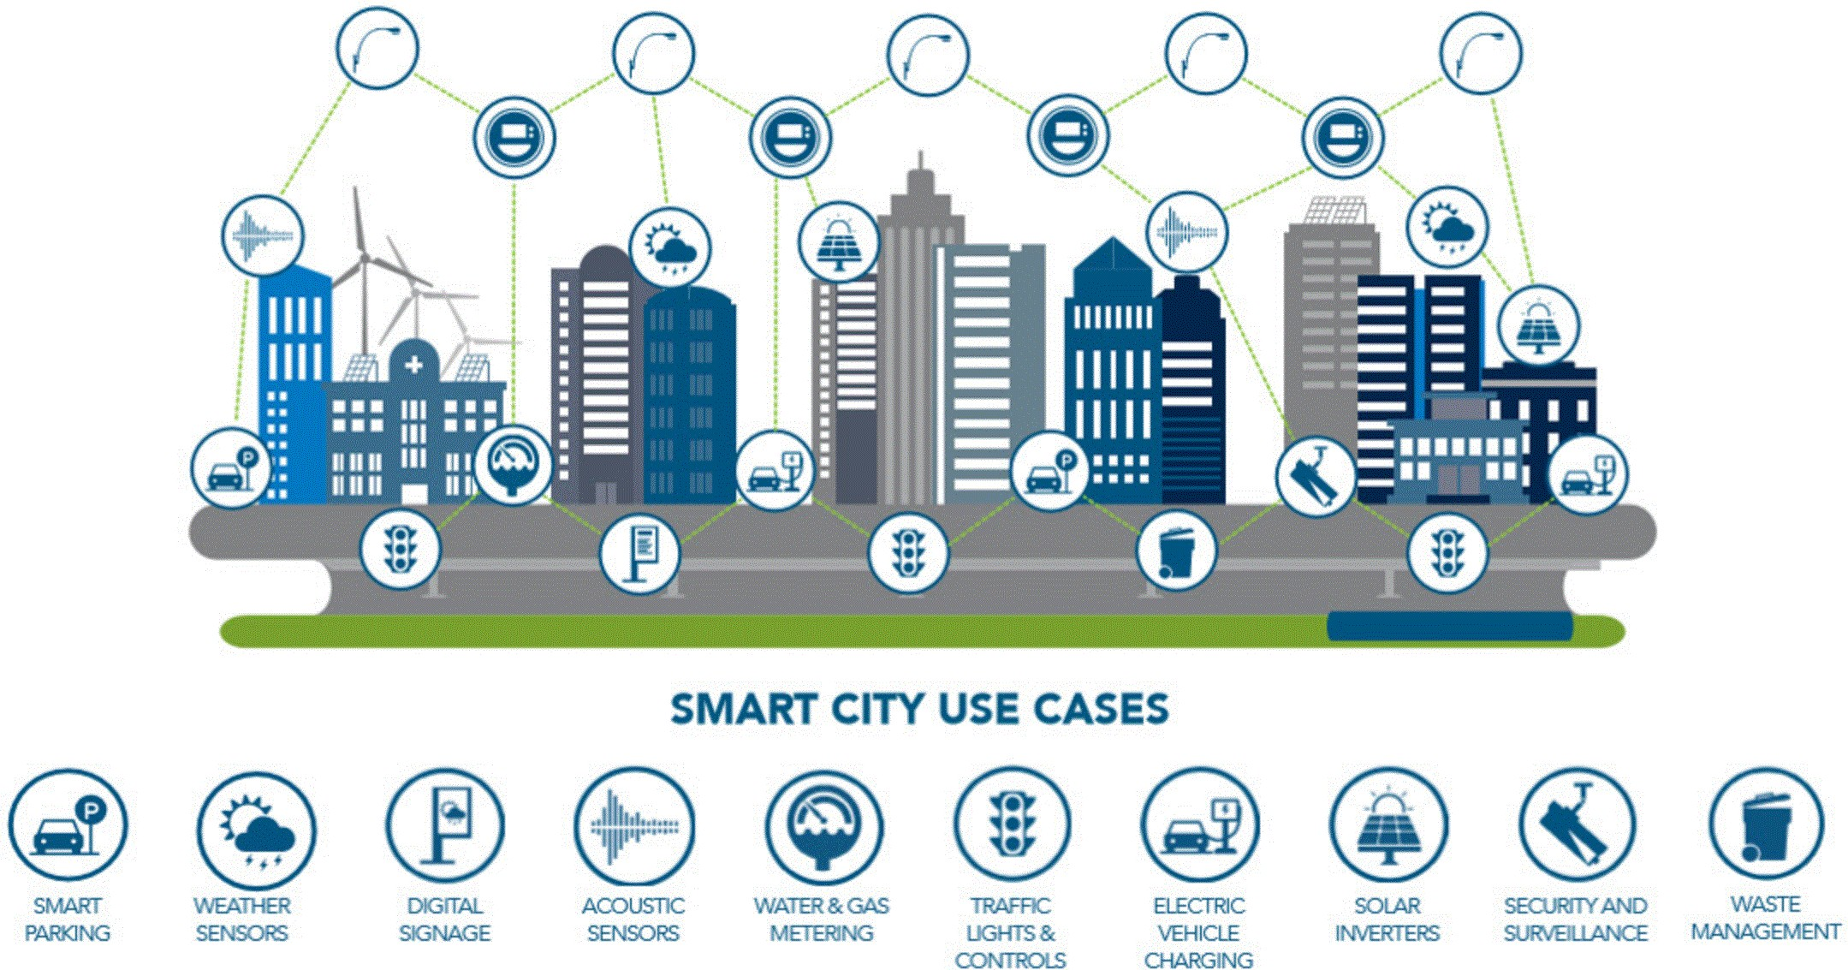
Smartcity – IOT Solutions
Smart Cities – M2M Applications Everywhere

Slide 15
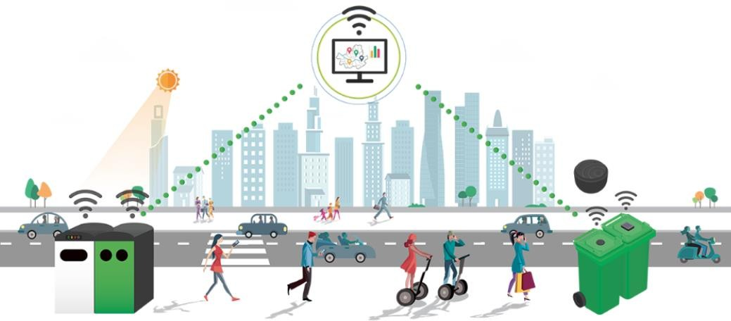
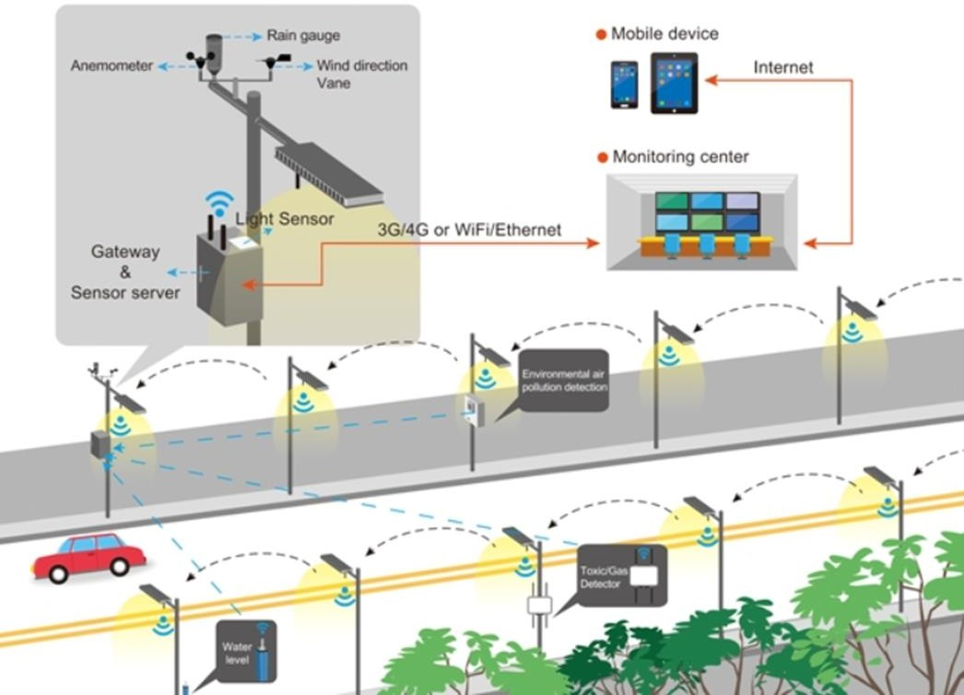
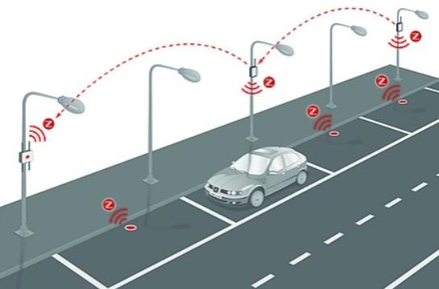
Smart Solid Waste Management
Smartcity – IOT Solutions
Smart Lighting
Smart Parking

Slide 16
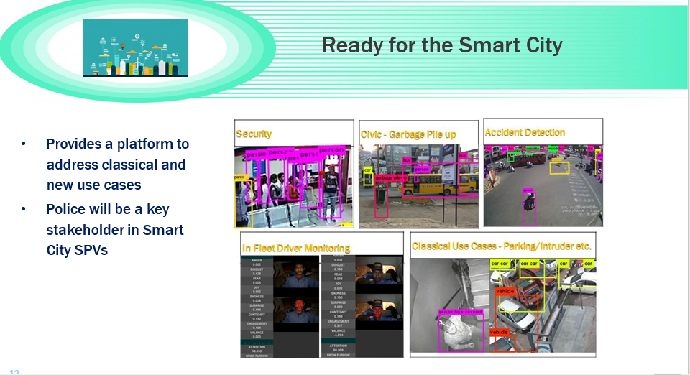
Smartcity

Slide 17
OUR SERVICES
Services
CCTV Surveillance
We draw on an extensive global network of partners to design security systems that integrate components from a broad range of product lines to ensure that the final solution best meets your needs.
Application Development
We are competent to develop custom software as per our clients requirements to serve with strategic benefits. By leveraging our in depth proficiency we are capable of providing robust solutions for dynamic websites, plugins, custom web applications.
Biometrics
We are one of the leading Biometric Solution Provider specializing in biometrics access control, Time & Attendance Solutions, Security systems for property, computer systems and network. Using the best of breed optical scanning sensors available in the market enables the seamless implementation of enterprise wide solutions that are fully integrated.
Consulting & Professional Services
Our consulting experts embrace your business needs and are with you throughout the lifecycle of your solution
Cloud Services
Experts in building clear strategy and road map on your cloud journey, so that you can move ahead confidently with your plan to adopt enterprise solutions in cloud environment.
RFID
The turnkey solutions and systems are developed using modern, robust and reliable active/passive RFID technology. We integrate a complete system or solution in the RFID technology right from its analysis and conception up to implementation and maintenance.

Slide 18
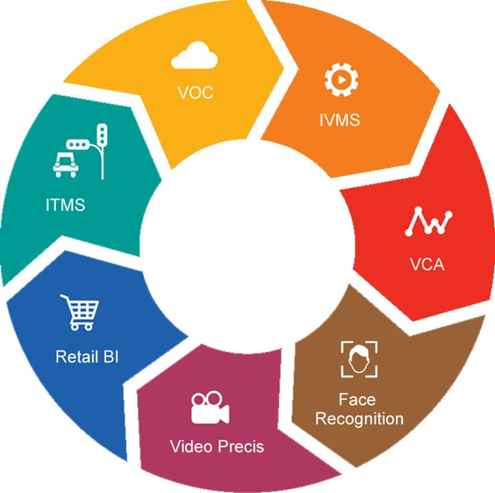
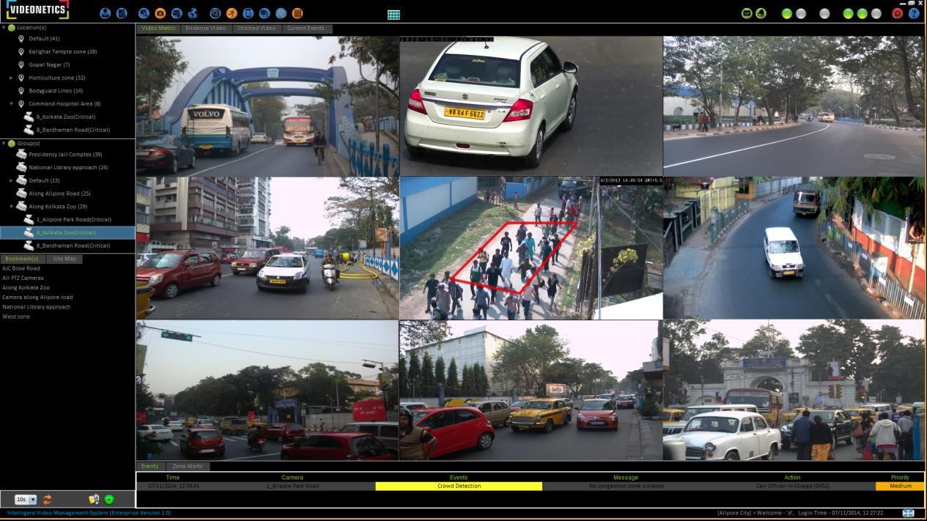
CCTV Surveillance
Intuitive & Integrated GUI
Integrated Visual Computing
Platform

Slide 19



Video Analytics Solutions
PEOPLE MONITORING
OBJECT MONITORING
TRAFFIC MONITORING
Activity Detection
Intrusion Detection
People Loitering
Dwelling
People Count
Zone Monitoring
Fence Jumping
Camera Tempering
Face Capture
Unattended Object
Object Removed
Object Tempering
Left Object
Obstruction
Crowd Monitoring Suite
Vehicle Congestion
Parking Violation
PTZ Tracking
Fixed Camera Handoff & Tracking
Vehicle stopping on road
Vehicle moving wrong way
License plate capture
Traffic light violation

Slide 20
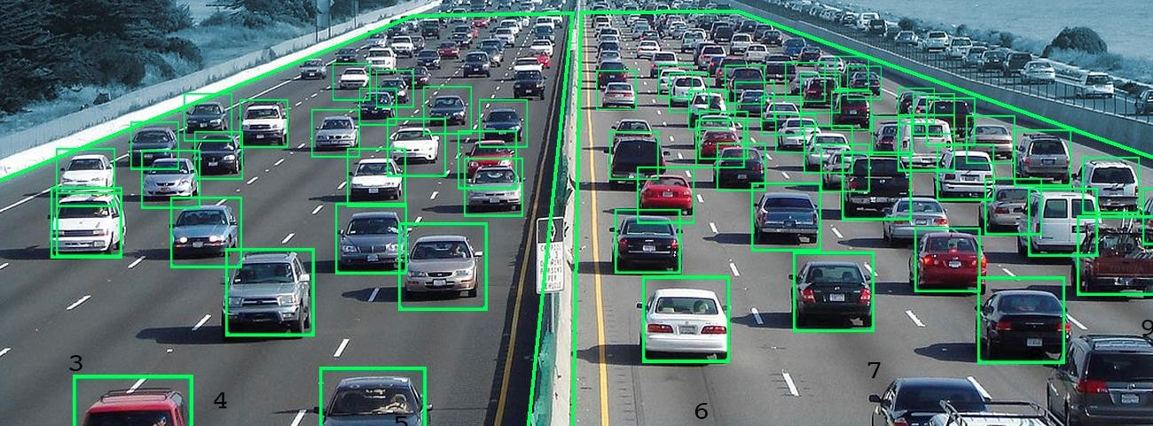
Traffic Monitoring Solutions
Automated Number Plate Recognition (ANPR)
Parking Violation Detection
Wrong way Detection
Sudden Congestion Detection
Traffic Volume Estimation
Intelligent Traffic Signal Monitoring by V-Loop
Red light Violation detection (RLVD)

Slide 21
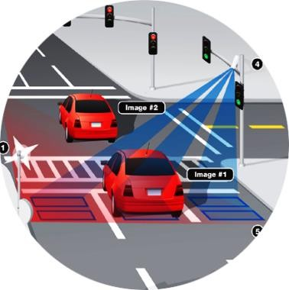
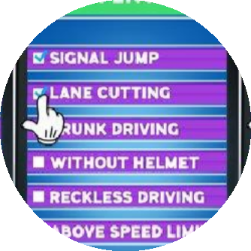
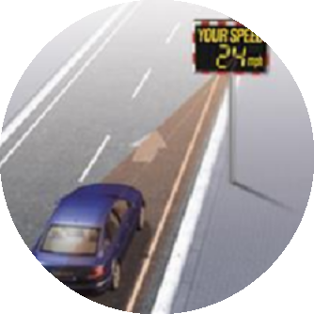
ITMS Solutions
RLVD SYSTEM
E-CHALLAN
VEHICLE SPEED MONITORING
Traffic light Violation.
Capture license plate of vehicles violating traffic rules.
Traffic signal monitoring and raise alarm if signal doesn’t change after assigned time.
Vehicle stopping on road.
Vehicle moving wrong way.
Generate challan for validated violation.
Integration with RTO database.
Auto email challan.
Challan online payment portal.
Challan payment tracker.
Vehicle speed detection.
Speed violation detection with evidence.

Slide 22

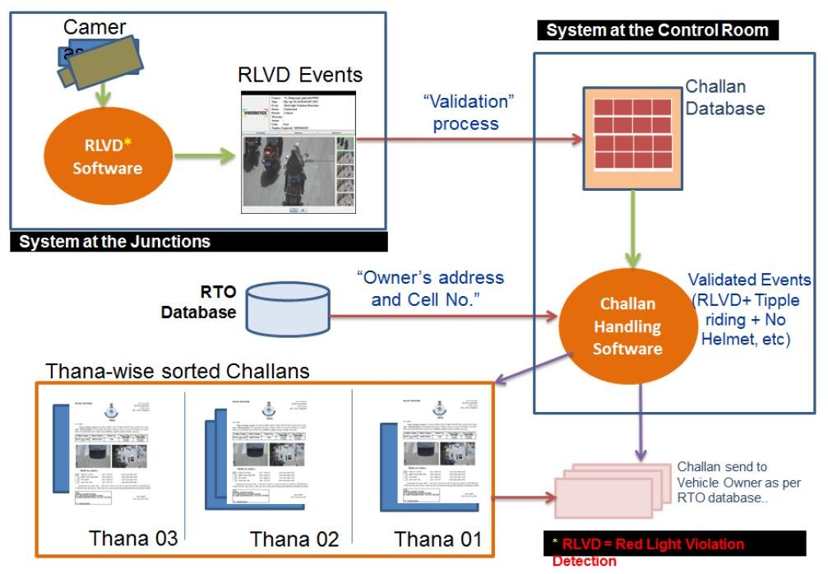
E-Challan Solutions
a
E-CHALLAN
The challans are generated automatically by the system, showing the details of the violation.
The challan contains images of the defaulting vehicle as evidence of the offence.
The challan generating application automatically connects to the RTO database, fetches the details of vehicle’s owner and populates all the information in the challan.

Slide 23
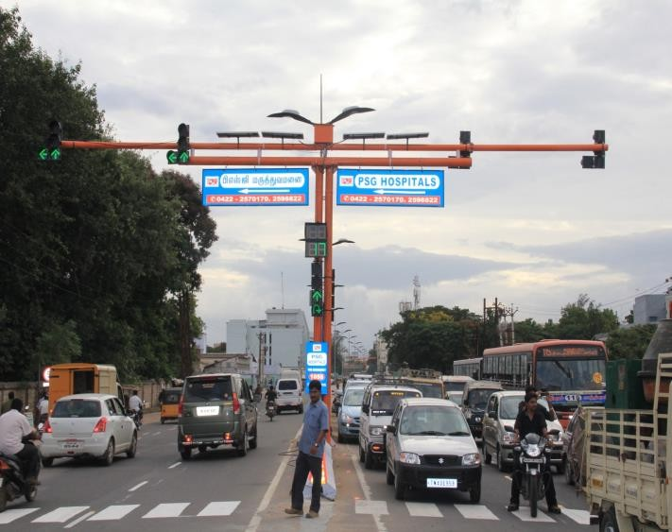
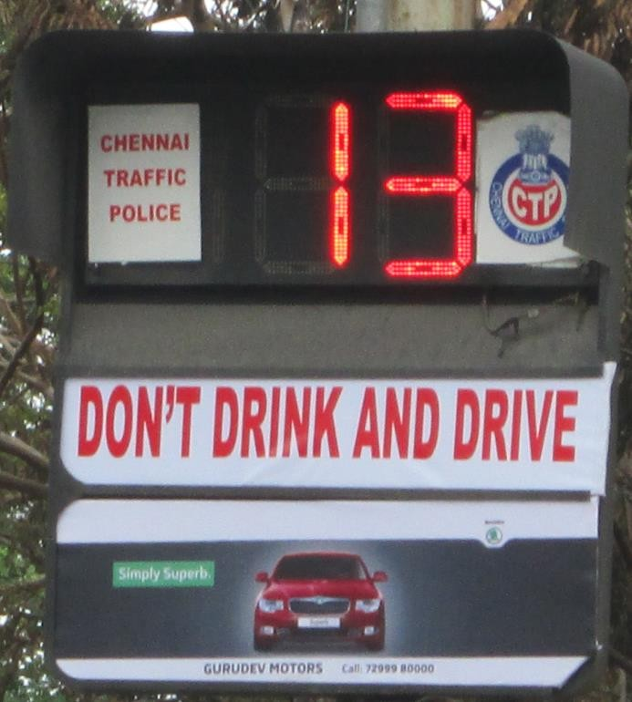
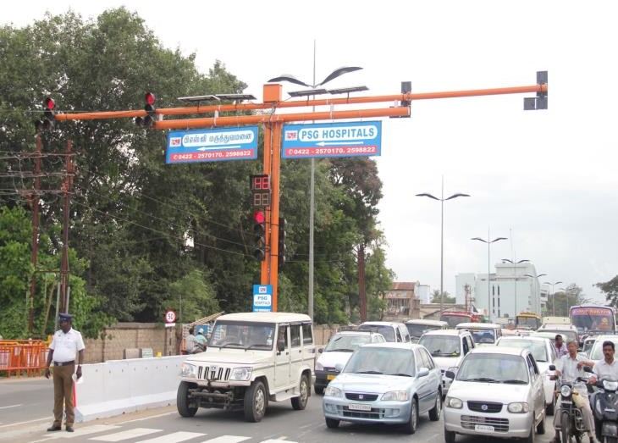
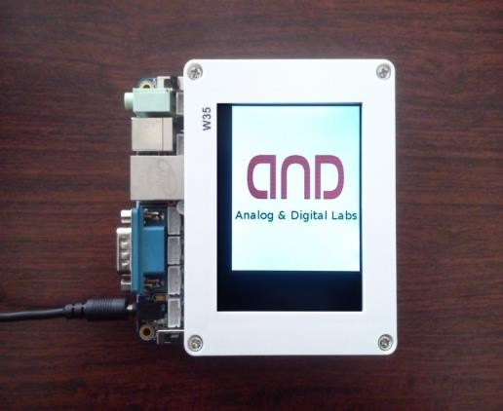
Traffic Signal Solutions
ATLAS(Advanced Traffic Light Assistance System)
Have Installed more than 300 Traffic Signals since from 2012.
Maintains 175 Numbers of Traffic Signals in Chennai City as a part of Annual Maintenance Contract
50 New Signals Installed in Ahmedabad, 218 Traffic Signal Maintenance Across
Ahmedabad.

Slide 24
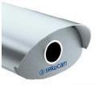
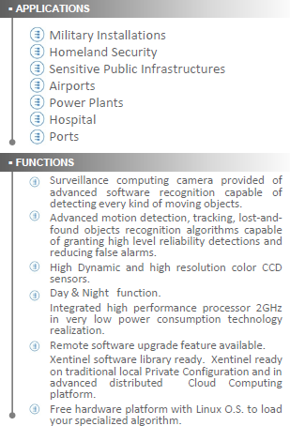
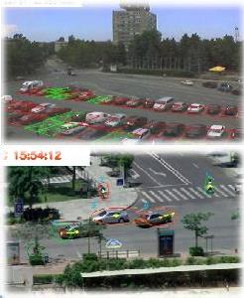
Security and Surveillance Solutions
Smart Tracking & Intelligent image detection
Detect and Track Day & Night any kind of moving objects

Slide 25
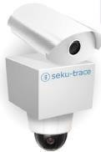
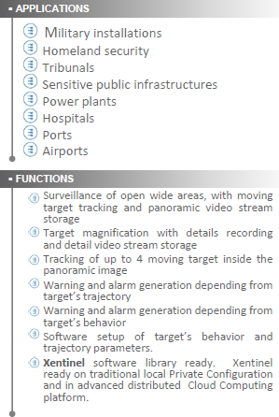
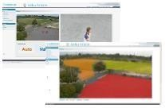
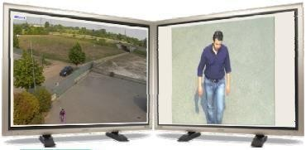

Security and Surveillance Solutions
Smart tracking & tracing subjects in motion
Track & Trace
objects in motion
Record video
warning & alarms

Slide 26

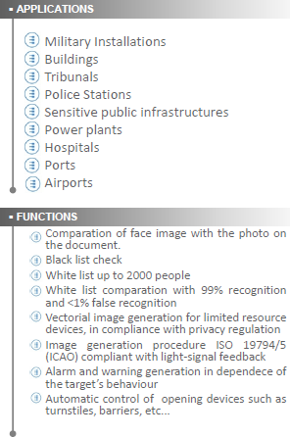
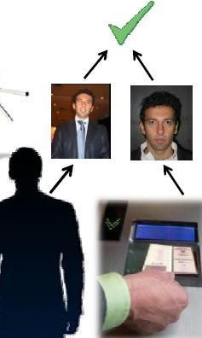
Security and Surveillance Solutions
Smart Biometric Face Detection
Face Detect Recognize Black/White List Warning & Alarms Lock/Unlock

Slide 27
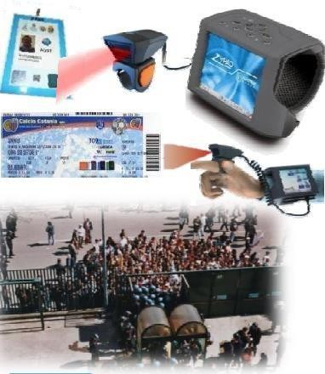
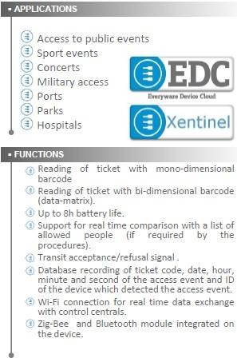
Security and Surveillance Solutions
Smart Access Control in Mobility
Mono & 2D barcodes
Black/White List Lock/Unlock Record all data

Slide 28
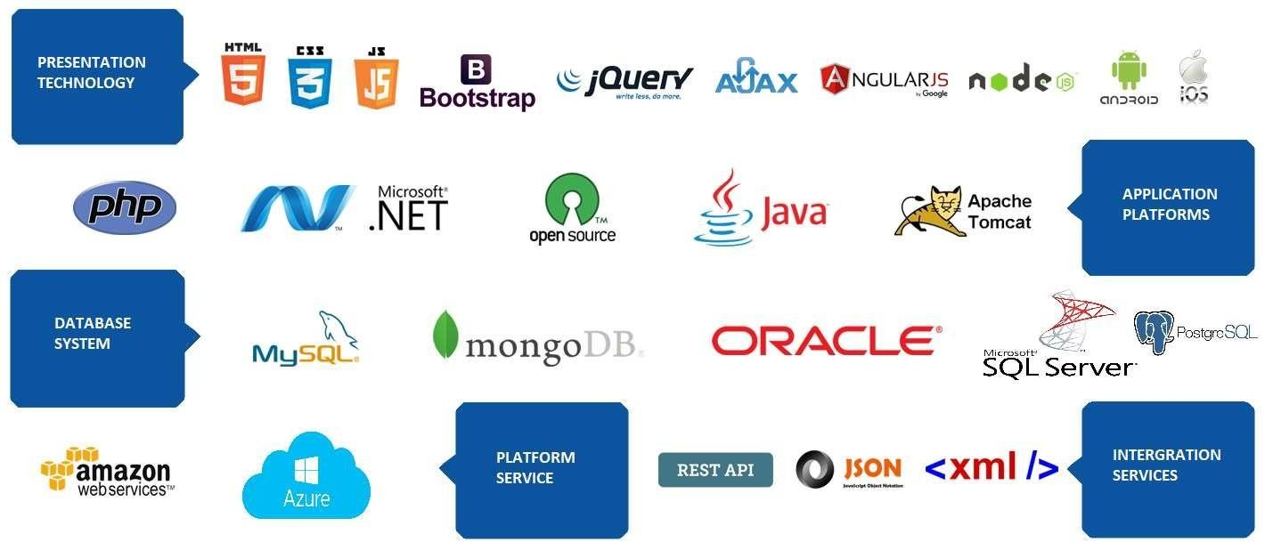
Technology Expertise

Slide 29



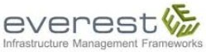











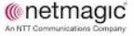
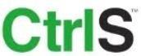



























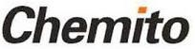







Smartcity – OEM/Ecosystem Partners

Slide 30








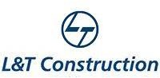
Clients

